Slide 1
Principles of Drug Discovery
Lecture 5: Hit Finding
Notes:
6/5/17
1
1

Slide 2
Hit Finding:
A hit is defined as a compound which shows activity on the target of interest and which has the potential to be further optimized into a drug candidate
There are several strategies and technologies available for hit finding:
High-Throughput Screening
Fragment-Based Drug Discovery
Virtual Screening
Knowledge-based approaches

Slide 3

Lecture 5a: Screening of Compound Libraries

Slide 4
What are we actually looking for?
A drug has to be:
active on the target of interest at low doses (Potency)
not active on other targets (Selectivity)
not toxic
not mutagenic
orally available to be administered via tablets (Bioavailability)
long enough in the systemic circulation to maintain its action over an adequate period of time (several hours)
The art of drug design is to design molecules which fulfil these requirements.

Slide 5
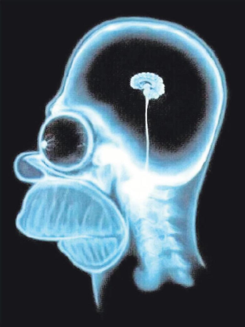
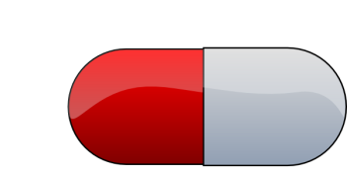

Bioavailability
Analysis of clinical trial failures in the early 90s showed that a significant number of failures can be attributed to poor bioavailability.
Target
Brain
Mouth
Portal vein
Stomach (pH=1)
Liver
Blood -
Systemic Circulation
Intestine (pH=7)
Metabolism
Gut wall

Slide 6
To reach systemic circulation upon oral administration compounds must:
Dissolve -> sufficient aqueous solubility
Permeate through the gut wall -> sufficient lipophilicity
Pass the liver -> resistance against metabolizing enzymes

Slide 7
Lipinski’s Rule of 5 (Ro5)
Compounds have a higher chance for bioavailability if:
The number of hydrogen bond donors is not greater than 5
The number of hydrogen bond acceptors is not greater than 10
The logP is not greater than 5
The molecular weight is not greater than 500
logP: Logarithm of the octanol/water partition coefficient -> measure for lipophilicity
logP = 1: molecule partitions with a ratio of 10/1 between octanol and water
logP = 6: molecule partitions with a ratio of 1 million/1 between octanol and water

Slide 8
The Ro5 is a very crude rule of thumb with many exceptions known in the scientific literature.
Yet, it is a useful and has a scientific rationale
Lipophilic compounds usually have poor solubility
Permeability depends on size, hence large molecules have a higher risk to be poorly permeable
Very hydrophilic molecules do not permeate well across biological membranes. Counting the number of hydrogen bond donors and acceptors is a surrogate for polarity.
For a drug discovery project is usually a bad idea to start with molecules which already violate one or more of the Ro5.
The Ro5 therefore are often used as criteria to design screening pools.

Slide 9
The Chemical Space
The chemical space is a concept in cheminformatics referring to the universe of molecules which are theoretically possible within a set of boundaries.
Let a molecule:
1) consist of the elements C,H,N,O and S
2) obey to the Ro5
3) have at most 30 heavy atoms
4) consist at most of 4 rings
These boundaries roughly approximate the pharmacologically interesting chemical space.
The theoretical number of different molecules which fulfil these boundaries has been estimated to be in the order of 10⁶³.
So, no matter what size a screening pool has, it is much less than a single water molecule in an ocean compared to the theoretical size of the pharmacologically relevant chemical universe.

Slide 10
Screening Pools
All big pharma companies have assembled large screening pools for the purpose of hit finding.
Sources of screening pools are:
Compounds from previous projects
Vendors
Inhouse efforts largely based on combinatorial chemistry
Handling and assembly of screening pools is a substantial manual and logistic effort
Solubilization and storage in standardized tubes
Sophisticated inventory system with barcodes
Robot systems
Size of compound collections of big pharma companies: 1-5 million

Slide 11
High-Throughput Screening
The general idea of High-Throughput Screening (HTS) is to test large numbers of compounds in a fully automated assay system

Slide 12
Key issues for high-throughput screening
Automation (screening robots)
Miniaturization
Precise handling of tiny amounts of liquids
Accurate detection methods
Costs for a HTS run can be quite substantial depending on required reagents (cells, antibodies, dyes, ……).

Slide 13
High-Throughput Screening
Modern HTS systems have a throughput (depending on the assay system) of up to 50,000 single dose measurements per day.

Slide 14
High-Throughput Screening Workflow
~1,000,000 compounds
Single-dose
Single-dose
confirmation
few thousand
Dose-Response
IC50/EC50 determination
few thousand

Slide 15
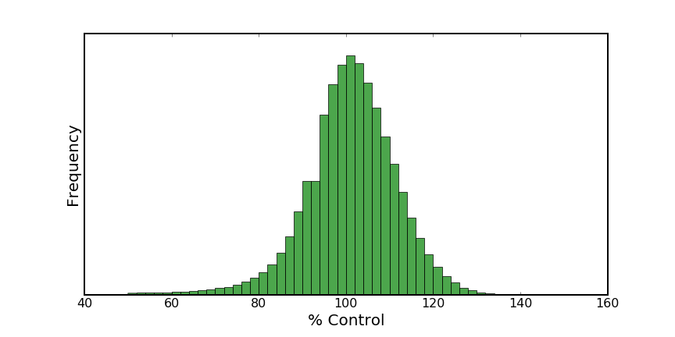
Result of a HTS run on 935,000 cpds
Very low hit rate of only 1.5% of the screened cpds reduce the signal to <70 % control.
Compounds which significantly reduce assay signal
(Inhibition/Antagonism)
Compounds which significantly increase assay signal
(Activation/Agonism)

Slide 16
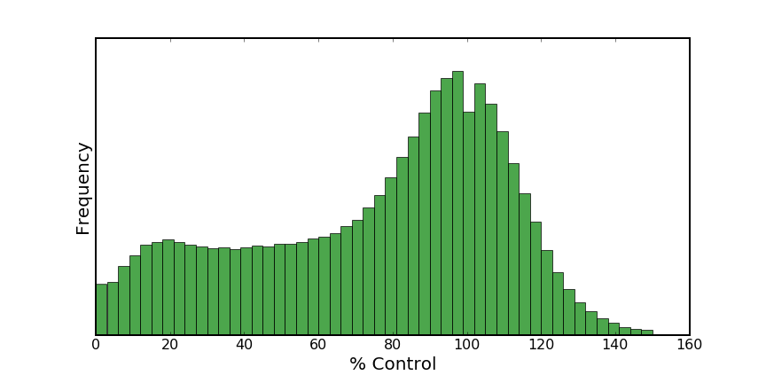
Result of a HTS run of 1,150,000 cpds on a voltage-gated ion channel
Extremely high hit rate with 27% of the screened cpds inhibit the ion channel by more than 50%.

Slide 17
Hit rates can vary substantially between different targets
Targets with large lipophilic binding sites (voltage-gated ion channels) bind many organic molecules
Targets which do not naturally bind small molecules often exhibit very low hit rates

Slide 18
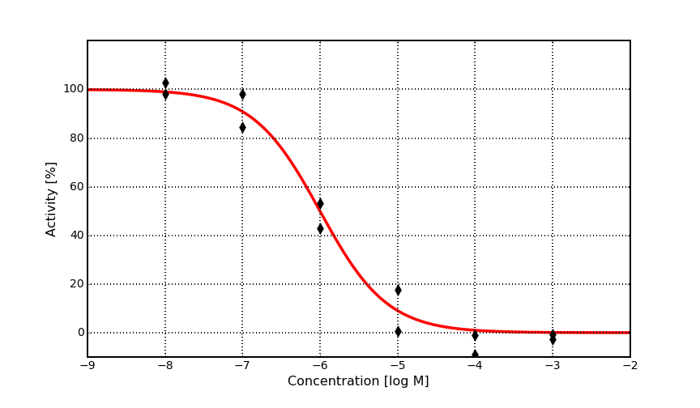
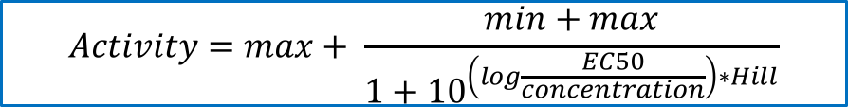
Dose Response Curve for EC50 Determination
$$Activity=max+ \frac{min+max}{1+{10}^{\left(log\frac{EC50}{concentration}\right)∗Hill}}$$
max: Maximum activity
min: Minimum activity
Hill coefficient: Slope of the curve
EC50: concentration at which half maximal effect is reached

Slide 19
False Positives
In every screen one finds compounds which interfere with the specific screening technology due to
680 nm
¹O₂
D
A
Quenching
Aggregation
Chemical reactivity
Impurities from synthesis steps (metal ions)
Other reasons
680 nm
¹O₂
D
A

Slide 20
Certain compound classes (structural motifs) are very prone to assay interference. These are called frequent hitters.
Redox-Cyclers can produce H₂O₂ under certain conditions which interferes with a wide range of HTS assays.

Slide 21
Curr Opin Chem Biol. 2011 Feb; 15(1): 174–182.

Slide 22
Found as hit in 63 of 175 screens
Found as hit in 124 of 185 screens
Found as hit in 58 of 179 screens
Found as hit in 64 of 182 screens
Found as hit in 130 of 193 screens
Found as hit in 50 of 104 screens

Slide 23
In order to reduce assay artifacts, it is common practice to establish a so-called technology counter screen and to follow up only those cpds which are not active in the counter screen.
Starting chemical optimization on assay artifacts can become a very costly endeavor. Therefore careful examination and qualification of HTS hits should be carried out before embarking on any synthesis activities.

Slide 24
High-Throughput Screening – Screening Cascade
~1,000,000 compounds
Single-dose
Single-dose
confirmation
few thousand
Dose-Response
IC50/EC50 determination
few thousand
Technology Counter Screen(s)
few thousand

Slide 25
High-Throughput Screening– Screening Cascade
~1,000,000 compounds
Single-dose
Single-dose
confirmation
few thousand
Technology Counter Screen(s)
few thousand
Dose-Response
IC50/EC50 determination
few thousand

Slide 26
Off-Targets
Other reasons for doing a counter screen are so-called off-targets. Closely related proteins for which selectivity is mandatory.
When screening with a cell-based assay system, active compounds might also interfere with other parts of the pathway which eventually results in a change of the assay signal.
IP₃ Cascade
Endoplasmic reticulum Ca⁺² release
409 nm
Dye

Slide 27
High-Throughput Screening – Screening Cascade
~1,000,000 compounds
Single-dose
Single-dose
confirmation
few thousand
Dose-Response
IC50/EC50 determination
few thousand
Off-target Counter Screen(s)
few thousand

Slide 28
High-Throughput Screening– Screening Cascade
~1,000,000 compounds
Single-dose
Single-dose
confirmation
few thousand
Off-target Counter Screen(s)
few thousand
Dose-Response
IC50/EC50 determination
few thousand

Slide 29
High-Throughput Screening – Screening Cascade
Primary HTS
Single-dose
confirmation
Off-target Counter Screen(s)
Technology Counter Screen(s)
Dose-Response
IC50/EC50 determination
Biophysical Assay/Xray
Cell-based functional Assay
Establishing a good screening cascade is essential to start chemical synthesis only on compounds which are qualified hits on the target of interest.

Slide 30
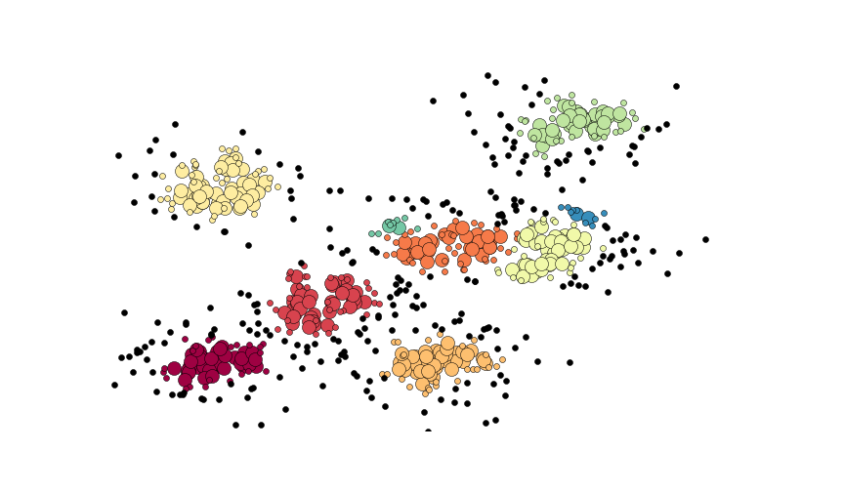
HTS Data Analysis
HTS runs deliver usually several hundred to several thousand hits. The first step to work up the data is usually to cluster the hit set based on chemical similarity.
Clustering is a standard technology in data science with a whole bunch of different algorithms which can be used. But they all require a measure of similarity.

Slide 31
How to describe molecular similarity?
Molecules are 3-dimensional. Correct similarity calculations would therefore include computation of the 3-dimensional structure(s), computation of the electron densities and subsequent comparison with the electron densities of other molecules.
For a clustering we need a similarity matrix. Hence, for a hit set of 1,000 molecule we need to compute 1,000x1,000/2 similarities. So we need something which is fast.

Slide 32
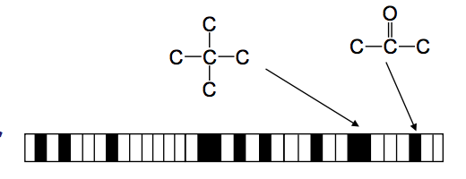
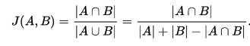
Molecular Fingerprints
A fingerprint is a binary vector where each bit represents a substructure pattern
Each element (bit) can either be ”1” if the pattern is present in a molecule or ”0” if it is not.
The similarity between two bit vectors can be computed by the so-called Jaccard (Tanimoto) index
Its value is 1 for identical fingerprints and 0 for completely different fingerprints
Its computation is very fast and commonly employed to compute similarities between large sets of molecules

Slide 33
Tanimoto Fingerprint Similarities
0.92
0.68
0.61
0.42
0.36
0.67

Slide 34
Hit Follow-Up/Exploration
The result of an HTS data analysis are usually several hit clusters + singletons (active compounds with no close neighbors in the hit set)
Within a hit cluster (chemical series) activities usually vary since not all variants fit into the binding site equally well. (If not this is a warning!)
12μM
500nM
900nM
2μM
600nM

Slide 35
Hit Follow-Up/Exploration
Exploration of a hit set also requires testing of more analogs (if available). Especially those which were inactive.
12μM
500nM
900nM
inactive
2μM
600nM
inactive
inactive

Slide 36
Hit Follow-Up/Exploration
12μM
inactive
900nM
500nM
inactive
inactive
600nM
2μM
Hydrophobic group needed, polarity reduces activity
Methoxy and hetero-aryl good, larger aliphatic substituent not tolerated
Acylation leads to inactivity. H-bond donor beneficial?

Slide 37
Structure-Activity-Relationships
In the ideal case, analysis of screening data already yields initial structure-activity-relationships (SAR), which gives the first idea of what chemical groups are preferred in certain positions.
These observations are the basis for the first chemical explorations of a chemical series to further substantiate the SAR
A chemical series with confirmed activity on the target and initial SAR is called a lead series.

Slide 38
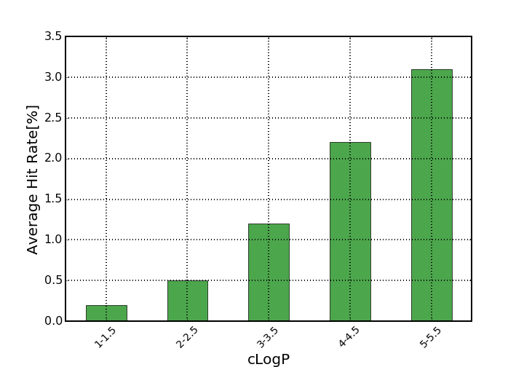
Considerations for the Selection of Hit Classes
Hydrophobicity:
Most ligand binding sites on proteins have lipophilic parts
Lipophilic compounds therefore have a higher tendency to appear as potent ligands in screening hit lists

Slide 39
In addition to polarity, molecule size is an important component to take into account to prioritize screening hits.
Larger molecules are often more hydrophobic and have more opportunities to form interaction with a target protein
During chemical optimization, the molecular weight usually increases. However, if molecules grow too large the risk to compromise bioavailability increases (Ro5).
It is therefore common practice to judge screening hits by metrics which in addition to potency take molecule size and lipophilicity into account.

Slide 40
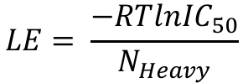
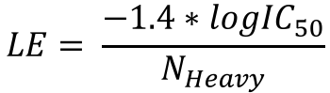
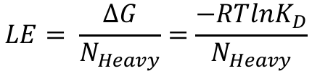
Ligand Efficiency
The activity of a ligand corrected by molecule size is called ligand efficiency (LE).
$$LE= \frac{∆G}{N_{Heavy}}=\frac{−RTlnK_{D}}{N_{Heavy}}$$
$$LE= \frac{−RTln{IC}_{50}}{N_{Heavy}}$$
N_{Heavy}: Number of non-hydrogen atoms
or
$$LE= \frac{−1.4∗log{IC}_{50}}{N_{Heavy}}$$
LE is usually expressed in kcal/mol/atom:
Ligand efficiency can be interpreted as binding affinity per atom and is frequently used for the analysis of hit sets.
N_{Heavy} = 17; IC50 = 8uM
LE = 0.41
N_{Heavy} = 32; IC50 = 250nM
LE = 0.28

Slide 41
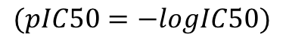
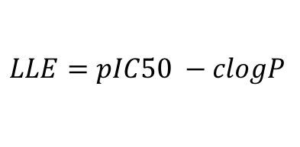
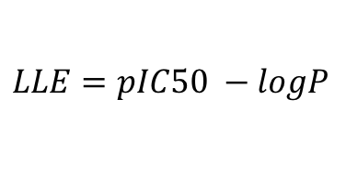
Ligand Lipophilic Efficiency
The activity of a ligand corrected by molecule size is called ligand lipophilic efficiency (LLE).
$$LLE=pIC50 −logP$$
$$(pIC50=−logIC50)$$
Since experimental logP values are usually not available when screening hits are analyzed computed logP values (clogP) are used.
$$LLE=pIC50 −clogP$$
N_{Heavy} = 17; IC50 = 8uM
clogP = 1.13
N_{Heavy} = 32; IC50 = 250nM
clogP = 6.25
LLE = 3.97
LLE = 0.35

Slide 42
Besides activity in the HTS assay, a number of other questions are important to clarify before costly chemical synthesis programs are started
What are the physico-chemical properties?
Truly active on target?
On which other targets was it active?
How is the synthetic feasibility for chemical exploration?
What targets do similar molecules hit?
Are closely related molecules also active?
Is this molecule or are closely related ones already covered by a patent?

Slide 43
Lecture 5b: Virtual Screening

Slide 44
Virtual Screening
Virtual screening is the computational/in-silico analog of experimental testing of large compound libraries
The most frequently used virtual screening method is molecular docking and requires structural information of the protein, in most cases a X-ray structure.

Slide 45
Molecular Docking
Docking is the pre-dominant structure-based virtual screening method
A docking algorithm tries to find the lowest energy conformation of a protein ligand complex (docking pose) and uses empirical energy functions to estimate the free energy of binding (score).
Due to efficiency reasons docking approaches are usually focused on a distinct binding site, e.g. the active site of an enzyme.

Slide 46
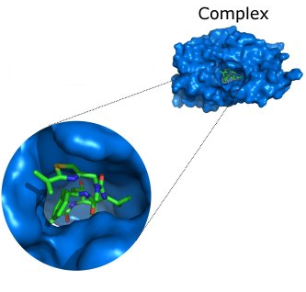
Components of docking software
Typically, protein-ligand docking software consist of two main components which work together:
1. Search algorithm
Generates a large number of poses of a molecule in the binding site
2. Scoring function
Calculates a score or binding affinity for a particular pose
To give:
The pose of the molecule in the binding site
The binding affinity or a score representing the strength of binding

Slide 47
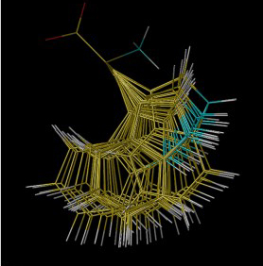
Handling protein conformations
Most docking software treats the protein as rigid
Rigid Receptor Approximation
This approximation may be invalid for a particular protein-ligand complex as...
the protein may deform slightly to accommodate different ligands (ligand-induced fit)
protein side chains in the active site may adopt different conformations
Some docking programs allow protein side-chain flexibility
For example, selected side chains are allowed to undergo torsional rotation around acyclic bonds
Increases the search space
Larger protein movements can only be handled by separate dockings to different protein conformations
Ensemble docking
Notes:
Tryptophan

Slide 48
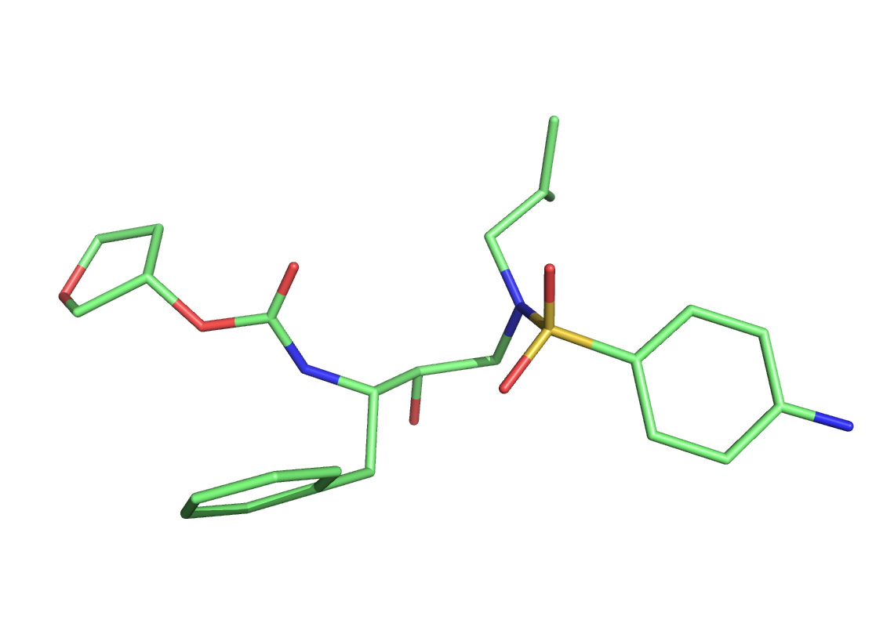
Handling ligand conformations
In most programs docking ligands are free to rotate around flexible bonds.

Slide 49
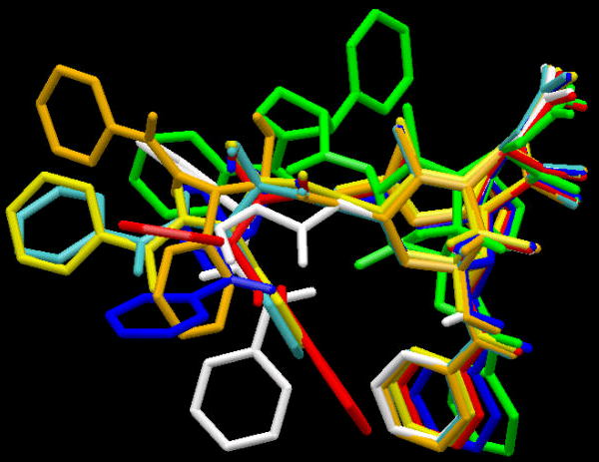
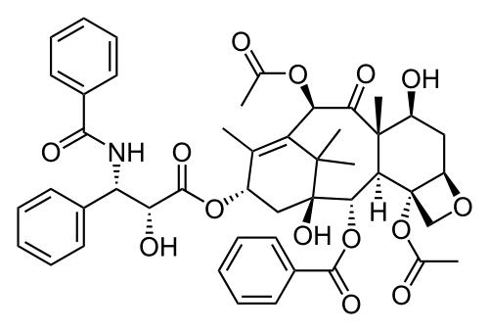
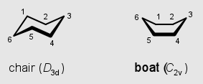
Handling ligand conformations
Taxol
For complex topologies, sampling the bioactive conformation can be quite tricky

Slide 50
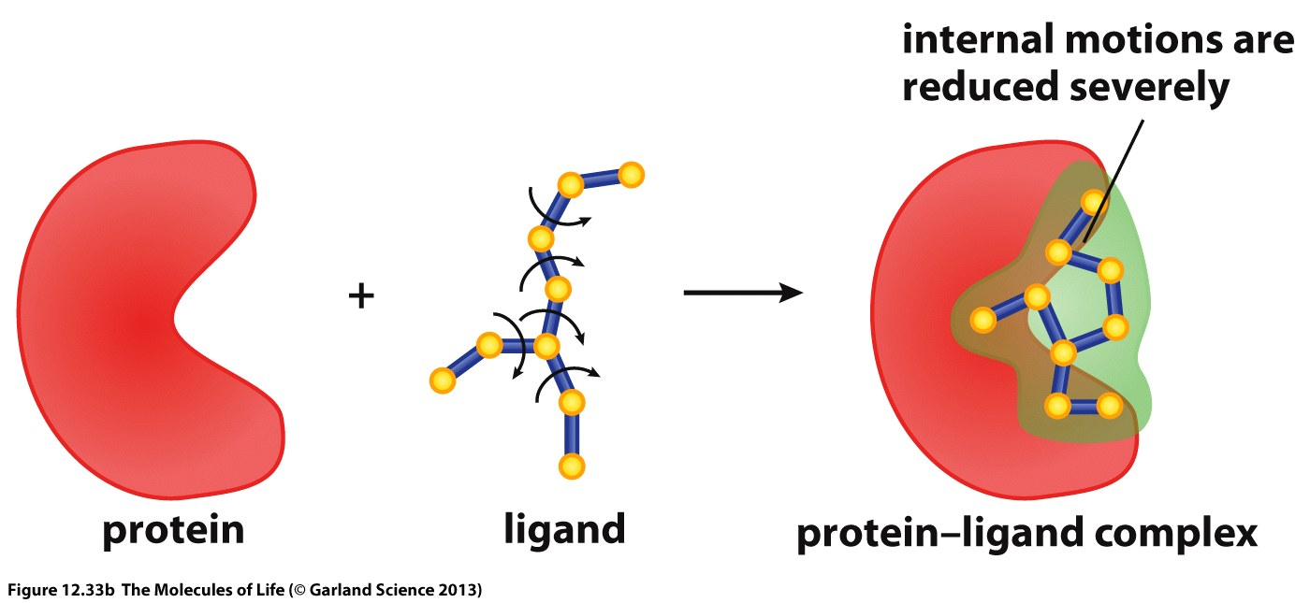
Binding of a ligand reduces the number of conformations a ligand can adopt which results in an entropic penalty. However, quantification of this penalty would require extensive computations.

Slide 51
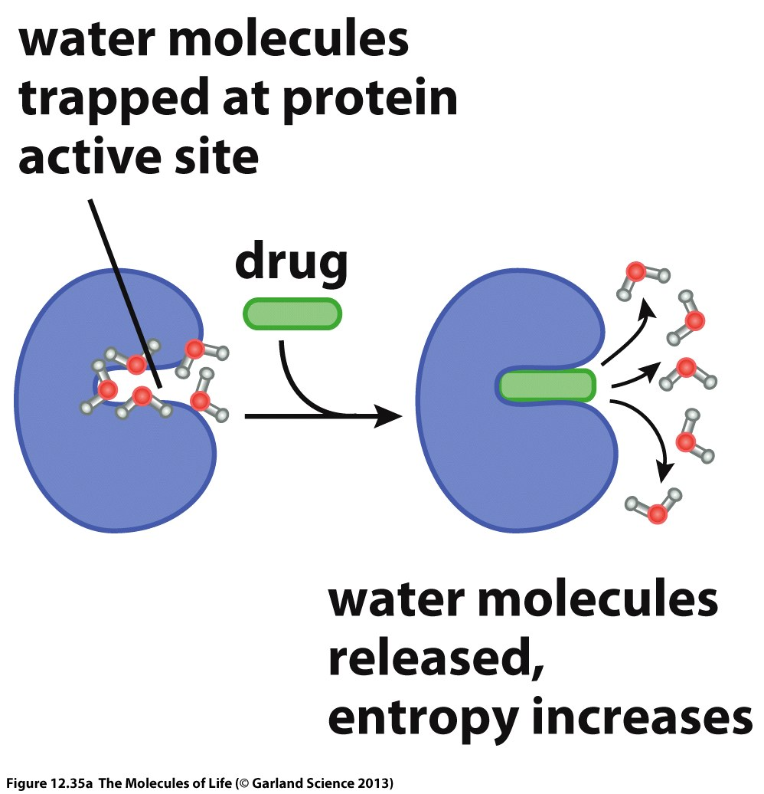
Another substantial entropic contribution comes from the release of water molecules from the binding site. Quantification of this contribution is not possible in fast computations.

Slide 52
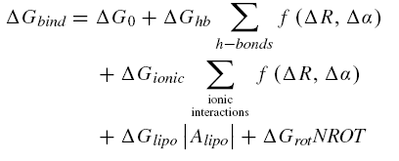
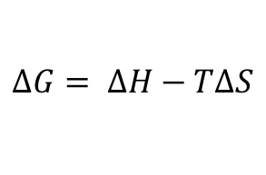
Scoring Functions
Computation of binding free energies would require to compute ensemble averages over all accessible conformations of the protein, the ligand and the resulting complex in solution which is not possible to achieve. Especially not if large compound libraries should be screened.
$$∆G= ∆H−T∆S$$
To allow rapid computation of an estimate of ΔG scoring functions have been developed which use empirical parameters and terms to account for desolvation and entropic contributions to binding.

Slide 53
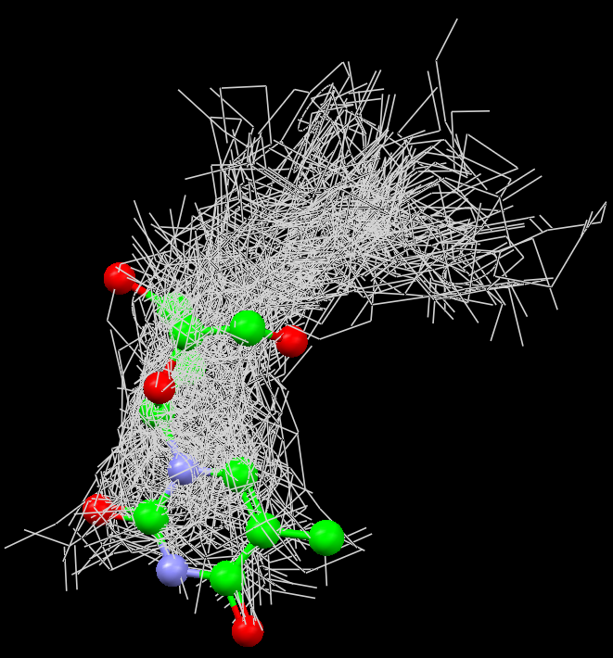
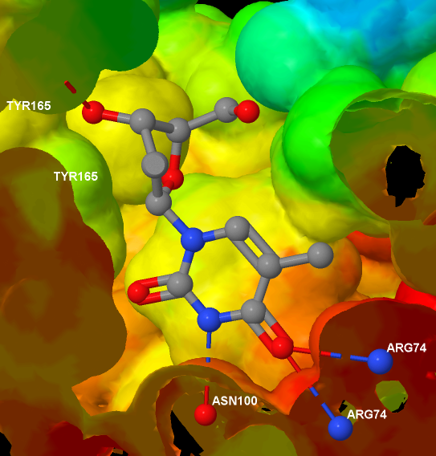
Pose Finding
Generate many poses
Score poses
Generate variations of the best scoring poses

Slide 54
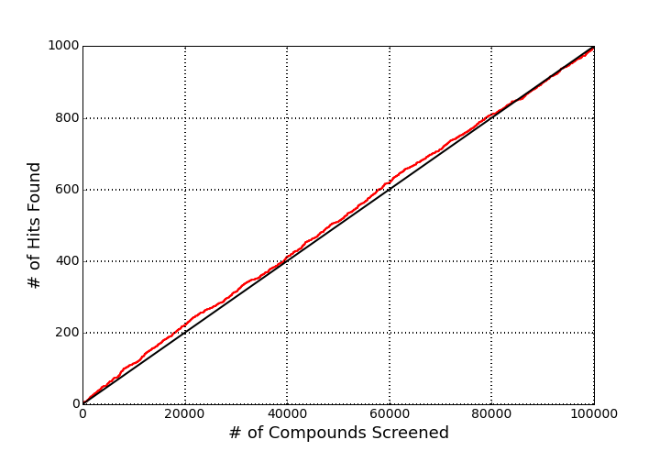
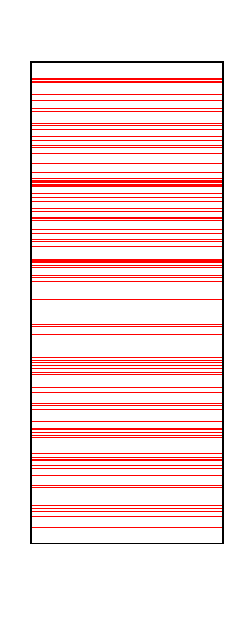
Docking Results: Enrichment
Active Molecules
Compound List
If a library of compounds is screened the appearance of hits is random
Hence, screening of only 10% of the library would mean that only 10% of the hits are found.

Slide 55
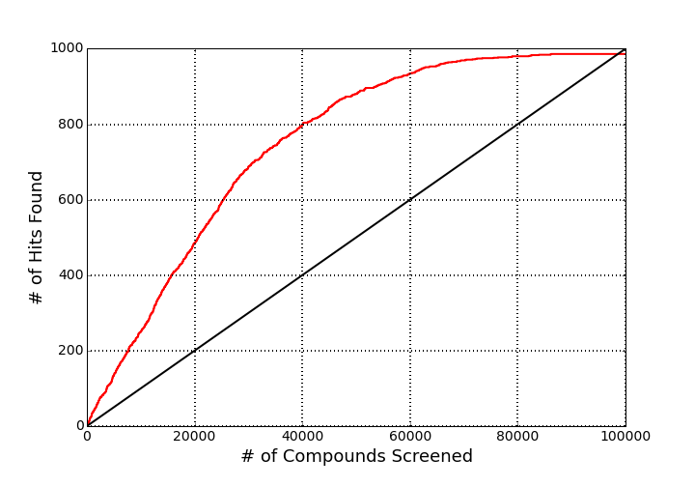
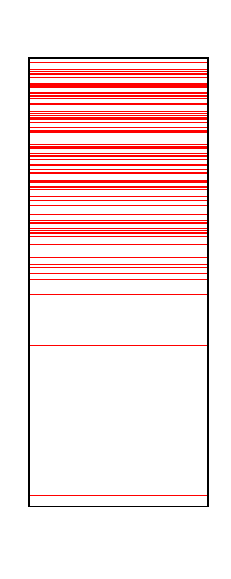
Docking Results: Enrichment
Active Molecules
Compound List
Docking scores do not correlate very well with binding free energies
However, they are usually good enough to filter out molecules which do not fit at all into the binding site and to find many of those which form favorable interactions with the target.
If one is limited in the number of compounds which can be tested experimentally docking is a useful method to select the most promising compounds

Slide 56
Computation of binding free energies is a substantial challenge and a very active field of research in theoretical biophysics
Structure-based virtual screening approaches like docking rely on crude approximations of the free energy of binding which explains there poor correlation with experimental results
However, docking approaches are often useful to identify the most likely binders and to discard molecules which do not fit into the binding site which makes docking approaches useful to select subsets of large compound libraries for experimental testing

